Slide 1








DATA ANALYTICS USING PYTHON

Slide 2
INTRODUCTION
THIS REPORT ANALYZES THE GLOBAL SUPERSTORE DATASET TO UNCOVER ACTIONABLE INSIGHTS FOR STRATEGIC DECISION-MAKING AND BUSINESS PERFORMANCE ENHANCEMENT.
KEY GOALS INCLUDE:
IDENTIFYING SALES AND PROFITABILITY TRENDS.
EVALUATING THE IMPACT OF DISCOUNTS AND SHIPPING COSTS ON PROFITS.
RECOMMENDING STRATEGIES TO OPTIMIZE REVENUE AND OPERATIONAL EFFICIENCY.

Slide 3
METHODOLOGY
1.
•Dataset Overview:
•- Source: Global Superstore dataset
•- Data: 24 attributes, 2,823 records
•- Tools: Python libraries (Pandas, Matplotlib, Seaborn)
2.
•Approach:
•- Data Cleaning and Preparation
•- Exploratory Data Analysis (EDA)
•- Insights Generation

Slide 4
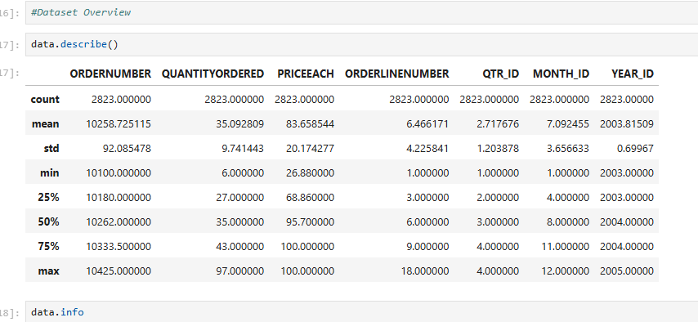
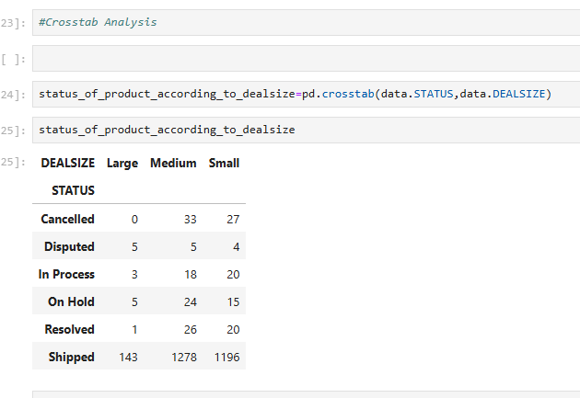
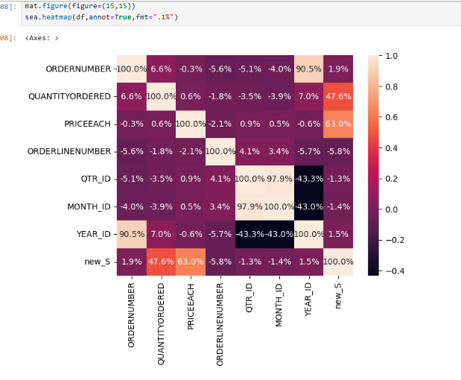
APPENDIX
PYTHON CODE SNIPPETS:
• Data cleaning and preparation.
• Crosstab analysis and visualization.
• Yearly sales trends and correlation analysis
.
•TOOLS USED:
•- Pandas, Matplotlib, Seaborn for analysis and visualization

Slide 5
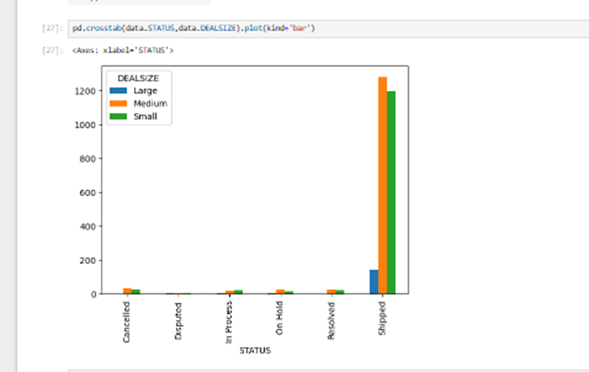
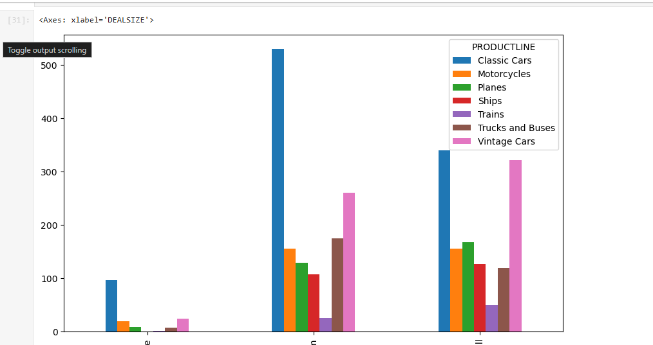
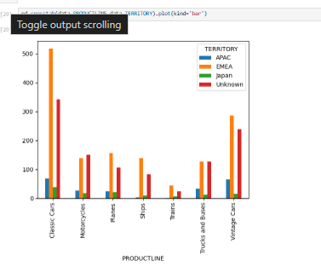
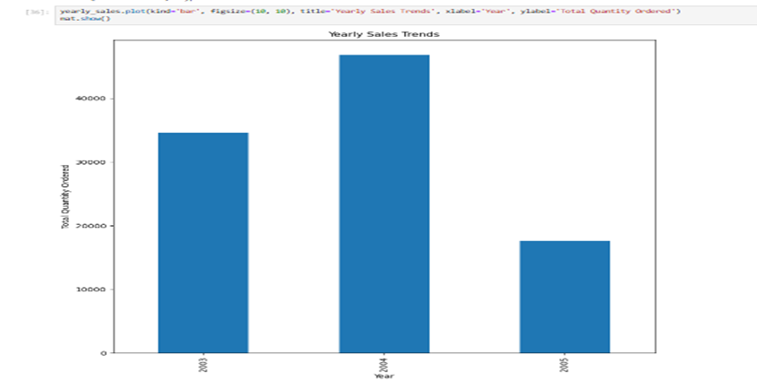
APPENDIX

Slide 6
INSIGHTS
Status Distribution by Deal Size
EMEA: Leads in sales for Classic Cars (518) and Motorcycles (138).
APAC: Strong in Vintage Cars (66) and Classic Cars (68).
Unknown Territory: Contributes significantly across product lines, especially Classic Cars (343).

Slide 7
INSIGHTS-2
Status Distribution by Deal Size
Large Deals:
Primarily shipped (143 orders), with minimal issues in other statuses.
Medium Deals:
Dominant volume, with 1,278 shipped and smaller proportions in other statuses.
Small Deals:
Significant contribution, with 1,196 shipped orders and notable counts in canceled (27) and disputed (4) statuses.

Slide 8
INSIGHTS-3
This bar chart visualizes sales data across different deal sizes categorized by product lines.
X-axis: Represents deal sizes, likely categorized as small, medium, and large.
Y-axis: Displays the count or sales numbers for the respective product lines.
Color-coded legend: Indicates different product lines, such as Classic Cars, Motorcycles, Planes, and others.
Observations:
Classic Cars dominate across all deal sizes, indicating they are the most popular or highly sold product line.
Vintage Cars have significant sales in large deal sizes but relatively lower in small and medium deal sizes.
Product lines such as Motorcycles, Planes, Ships, and Trains contribute less to sales compared to Classic Cars and Vintage Cars.
Trucks and Buses show moderate sales across the deal sizes but do not surpass the top performers.

Slide 9
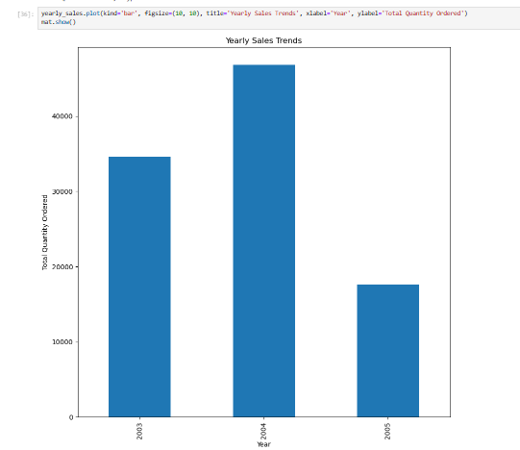
INSIGHTS-4
Observations:Yearly Sales Trends
2004 stands out as the year with the highest sales, exceeding 40,000 units.
2003 shows moderate sales, with the total quantity ordered slightly over 30,000 units.
2005 records the lowest sales, with a significant drop compared to the previous two years, likely below 20,000 units.
Insights:
Growth from 2003 to 2004: There is a notable increase in sales, indicating successful strategies or high demand during this period.
Decline in 2005: The sharp decline in sales may be due to factors such as market saturation, economic conditions, product obsolescence, or competitive pressures.

Slide 10
RESULTS AND ANALYSIS
Key Findings:
Sales range: $0.44 to $22,638.48, Average: $462.80
Profit average: $56.59, affected by high discounts
Shipping costs: Average $12.87, vary by region
Discounts: Range 0%-80%, impact on profitability
Highlights:
Central America: High sales but inconsistent profits.
EMEA leads in sales for Classic Cars.

Slide 11
DISCUSSION
•Observations:
•- Regional Performance: Untapped potential in Central America.
•- Discounts: Over-discounting impacts profitability.
•- Seasonal Trends: Strong Q4 sales; mid-year promotions needed.
•- Shipping Costs: High costs reduce profits in low-margin categories.
•
•Suggestions:
•- Tailored strategies for underperforming regions.

Slide 12
Thank
You

